Slide 1
Consequences of Poor Design
CS Makers

Slide 2
What happens when you don’t think when you design?

Slide 3
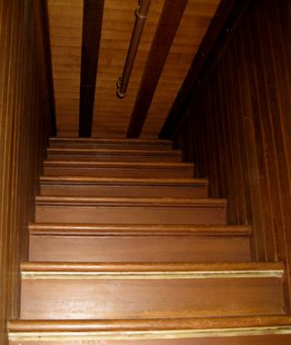
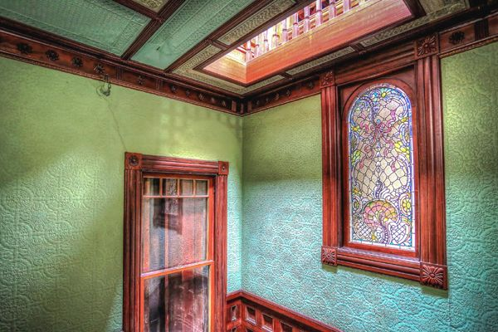
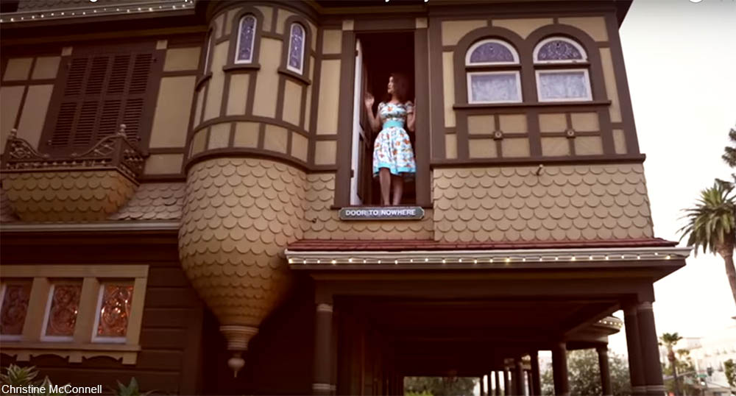
Poor design leads to makeshift structure
Ex: The Winchester Mystery House is the result of continuous building without any thought toward design.
Outcome:
Stairs going to ceiling
Windows in middle of room
Doors going nowhere

Slide 4
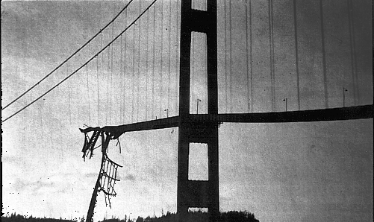
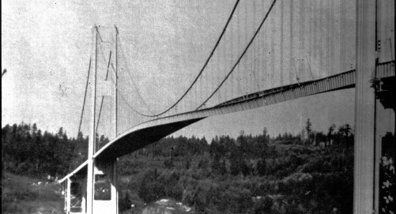
Bad design can cause disaster
Ex: Tacoma Narrows Bridge was built when aerodynamic phenomena in suspension bridges were not fully understood and these forces had not been addressed in this design.
Outcome:
Bridge collapse four months after construction
The remains are a permanent record of man's capacity to build structures without fully understanding the implications of the design.

Slide 5
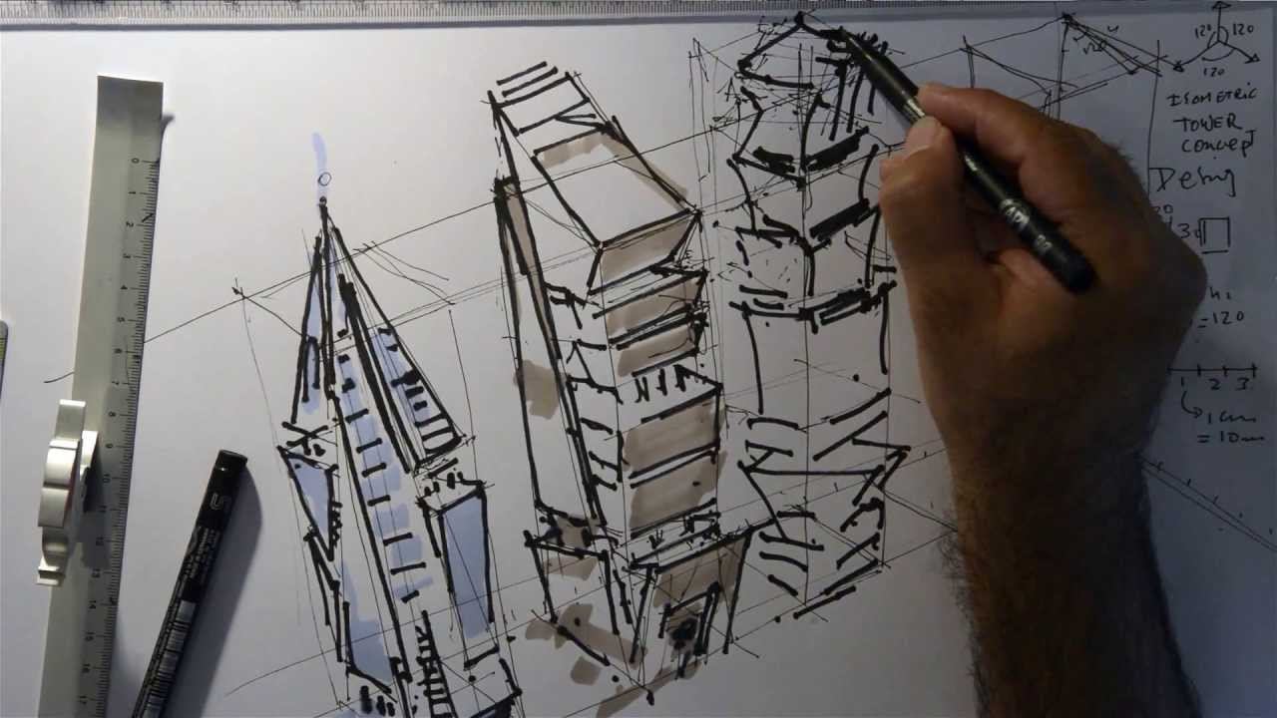
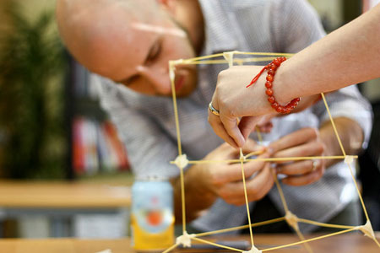
Three steps toward good design
Design: a plan for the construction of an object
Before building; create a sketch, discuss plan with others, etc.
Prototyping: to create an experiential model
All or part of a product may be created and tested to help make a well designed final product
Testing: experimenting to find out how well something works
Test the prototype to ensure it will perform as expected

Slide 6
THE
END

